Slide 1
Stepping 0ut

Slide 2
Stepping 0ut
… you will receive power when the Holy Spirit comes on you; and you will be my witnesses in Jerusalem, and in all Judea and Samaria, and to the ends of the earth.

Slide 3
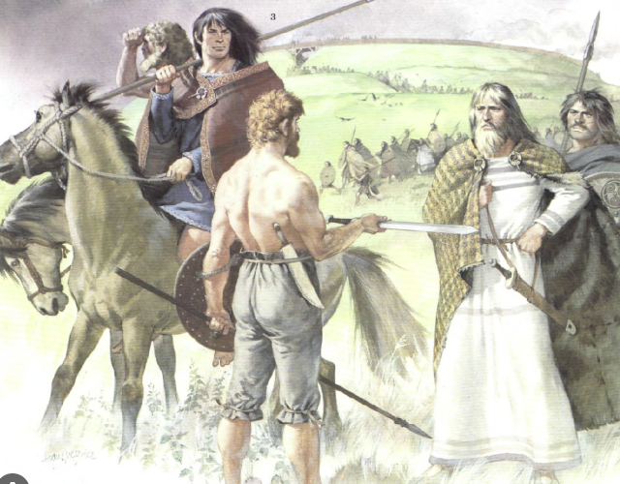
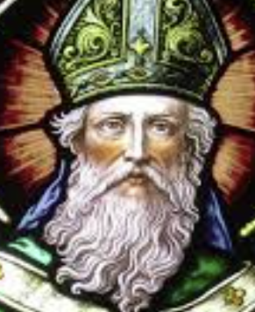
Stepping
0ut

Slide 4
Patrick:
raised in Britain after the the Romans left, attacks by the Irish in the west, Picts from the north and Saxons from the east.
captured as a slave at 16, converted, escaped to Britain, trained as monk / priest in France, returned to Ireland (with companions) to evangelise & establish many monasteries / churches.
died about 460 AD.
(Roman rule collapsed in France by 486)

Slide 5
Irish-Scottish Mission Movement:
Columba, Irish, -> Picts in Scotland, with 200 companions, est. bible school / monastery at Iona, 563 AD.
Dunod, Irish, -> Wales, est. bible school at Bangor with 2100+ students in 560 AD
Columbanus, Irish, trained at Bangor, -> Burgundy 590 AD, -> Austria -> Italy 615 AD.
Aidan, Irish, trained at Iona, -> Northumbria (northern England) in 634 AD -> ⅔ of Northumbrians converted at this time.

Slide 6
Wilibrord, from Northumbria, -> Frisans (Netherlands) 696 AD.
Boniface, from Devon, -> Hesse (central Germany) 716 AD
and many others…
And so … people with dedication and intent made a difference.

Slide 7
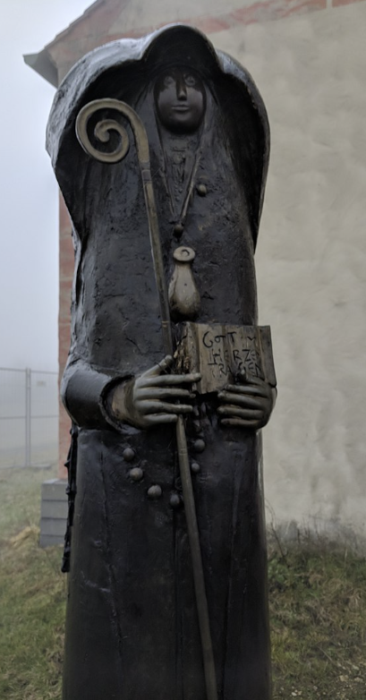
Bonus Fact:
Walpurga was the niece of Boniface, and is the first known female author from England, in Germany.

Slide 8
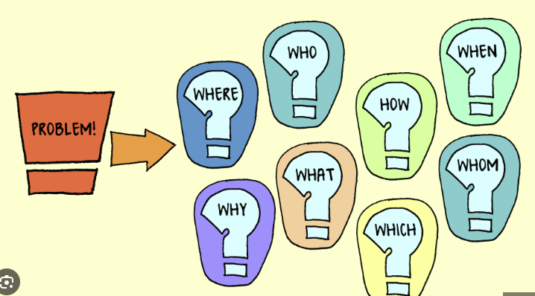
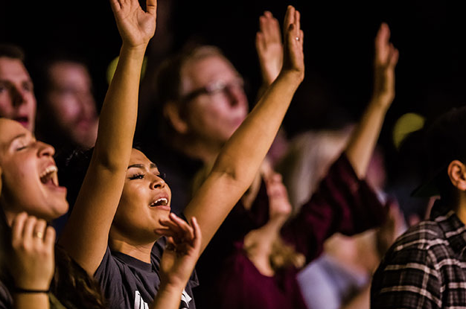
Life is a problem to be solved. |  | Life is an experience to be savoured.

Slide 9
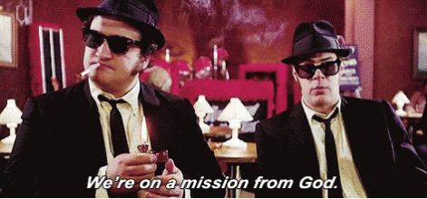
Life is a problem to be solved. |  | Life is an experience to be savoured.
We’re on a mission from God. |  | We are a community of believers.

Slide 10
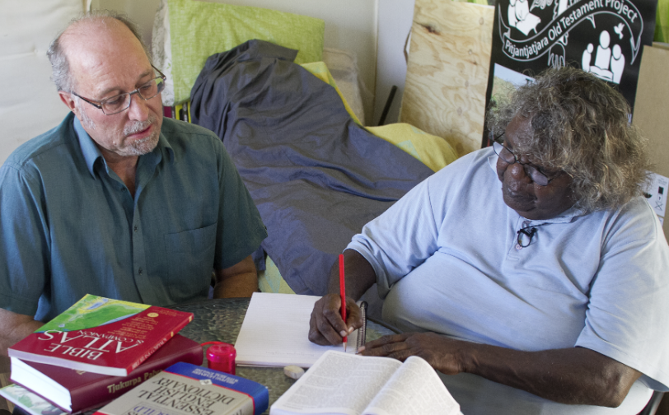
Life is a problem to be solved. |  | Life is an experience to be savoured.
We’re on a mission from God. |  | We are a community of believers.

Slide 11
Life is a problem to be solved. |  | Life is an experience to be savoured.
We’re on a mission from God. |  | We are a community of believers.
Mission - intentional, time sensitive, goal focussed |  | Community - relational, inclusive, life-time, program focussed
Maybe: Intentional, but humble and ready to listen Time sensitive, but inclusive and patient Goal focussed, but gentle and willing to put people first

Slide 12
We’re on a mission from God. |  | We are a community of believers.
… you will receive power when the Holy Spirit comes on you; and you will be my witnesses in Jerusalem, and in all Judea and Samaria, and to the ends of the earth. (Acts 1:8) |  | Each of you should use whatever gift you have received to serve others (1 Peter 4:10)
How to start? ‘just walk across the room’ Bill Hybels

